Slide 1

Introduction to Data Mining and Machine Learning
Final Project
Text Analytics & Deep Learning
Presented by
Saish Pai

Slide 2
Overview
Introduction
Text Analysis
Deep Learning
Next Steps

Slide 3
Introduction
Web scrapping
Data Cleaning
Visualization
Understand the requirements
Stemming
Analysis

Slide 4
Introduction
Why perform text analytics o reviews?
Web scraping means to extract data from the websites.
The data can be related to any entity , product, person or emotions.
In the project I have scrapped the reviews data from Amazon website for Amazon Kindle paperwhite e-reader.
This will allow us to understand the success or failure of the product, customer satisfaction and will help the company decide on what changes have to be implemented to eliminate the issue if any.
Dataset :
We will be analyzing over a 3760 reviews for this product.
Since it is an amazon product sold majorly on the company’s website the reviews provided on the website can be assumed to reflect the majority of the users and hence can be accurately used to judge the products performance.

Slide 5
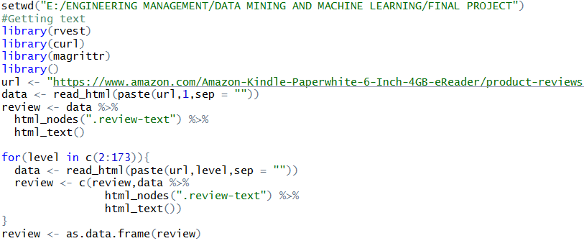
Web Scrapping
We have scrapped the data about the reviews for Amazon kindle paperwhite from the website
The rvest package is used to perform scraping thus making it easier to scrape the data from the html web pages.

Slide 6
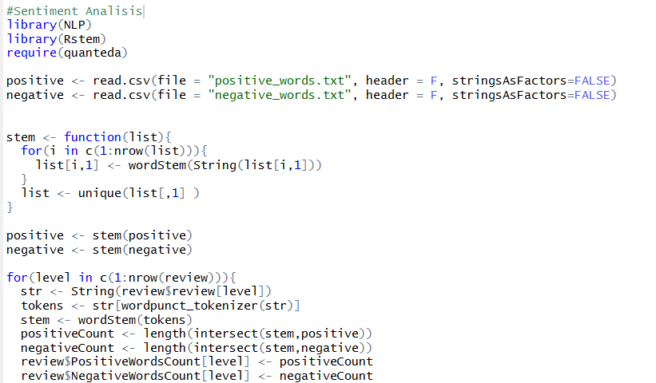
Sentiment Analysis
Sentiment analysis is natural language processing technique that is used to extract subjective information from the scraped text and determine the positive and negative sentiments attached to the text.
Stemming and Tokenization was performed.
Converting all characters to lower case and Text Trimming : removal of unwanted heading and tailing spaces, punctuations, digits and other URL links.
Corpus Created is compared with the positive and the negative words of the lexicon dataset to determine the scores of the positives and negatives.
Comparing the corpus containing the reviews review with both the positive and the negative lexicon dataset.

Slide 7
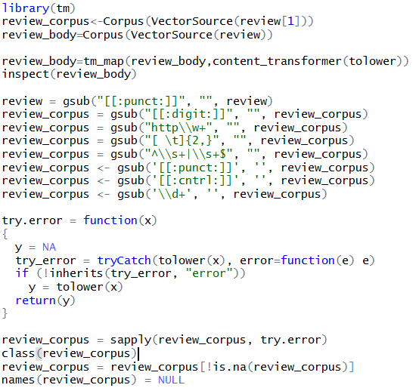
Cleaning the data
It is critical to clean the data before using it for analysis.
The data contains punctuations, articles and other elements which can clutter our analysis.
The code removes these elements and stores the corpus which can be used for further analysis.

Slide 8
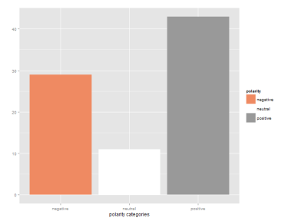
Output
Calculate the percentage match of the scores based on the number of matches.
Obtained the average value of the match score for positive and negative words
This provides us with a visual representation of the sentiments attached to the data and helps in analyzing it by just glancing through the plot.
As can be seen from the plot the count for positive reviews is more and hence its safe to assume that the product is doing well and the customers are satisfied with the performance.

Slide 9
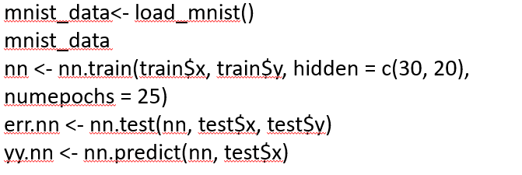
Deep Learning Algorithms
Loading the Mnist datset and using Neural nets
The second part of the project deals with implementing deep learning algorithms on the Mnist dataset.
Mnist dataset contains handwritten numbers between 0 and 9 including both.
The main purpose of employing deep learning algorithms here is to be able to identify these numbers.
We will be implementing neural net, DNN,RBN and CNN to try and accurately predict these numbers.

Slide 10
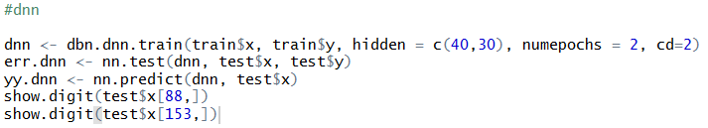
Deep Neural Network
Backward propagation is a common method of training a deep neural net, this along with the gradient descent technique helps the model to update and calculate the weight for each node

Slide 11
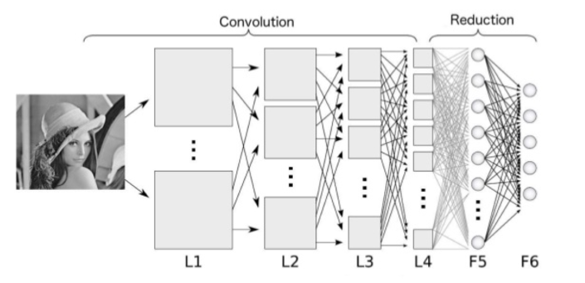
Convolutional Neural Network
CNN uses filters to develop receptive fields these are used by the network to learn the images and adjust the weight to get the required output.
4 Key techniques that are used for developing a CNN are as follows:
Forward pass
Loss Function
Backward pass
Weight update
Snippet from the 1st convolution layer.

Slide 12

Image from 1st Convolution layer
Snap of the image from the 1st convolution layer
Accuracy
Neural Network – 83.71%
CNN – 98.37

Slide 13
Next Steps and conclusion
Cleaning and scaling the scrapped data is critical to the analysis.
Performing analysis of various sentiments instead of just positive and negative segregation will help understand the actual problems associated with the product.
Using word cloud will help when the reviews are pertaining to a particular event or a person.
The question about longer reviews adding up to the positive/negative score will have to addressed.
Problem with Mxnet needs to be addressed.
Analysis should be done to identify which deep learning algorithm has to be used for a particular case.
Code to avoid the bot detection should be included to enable efficient scrapping.
Using deep learning techniques gives us significantly high accuracy as compared to the other models we have learnt before.
So KEEP LEARNING <- DEEP LEARNING

Slide 14
Thank You!

